Slide 1

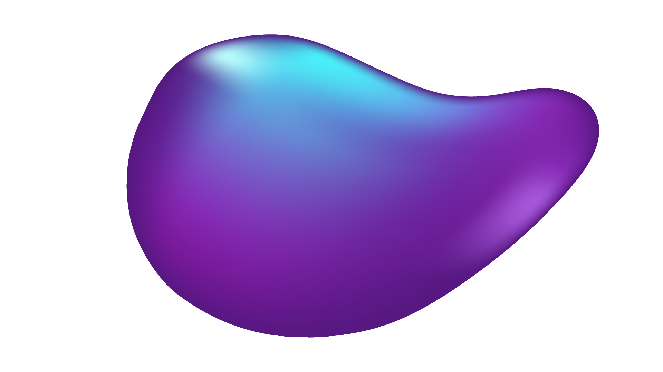
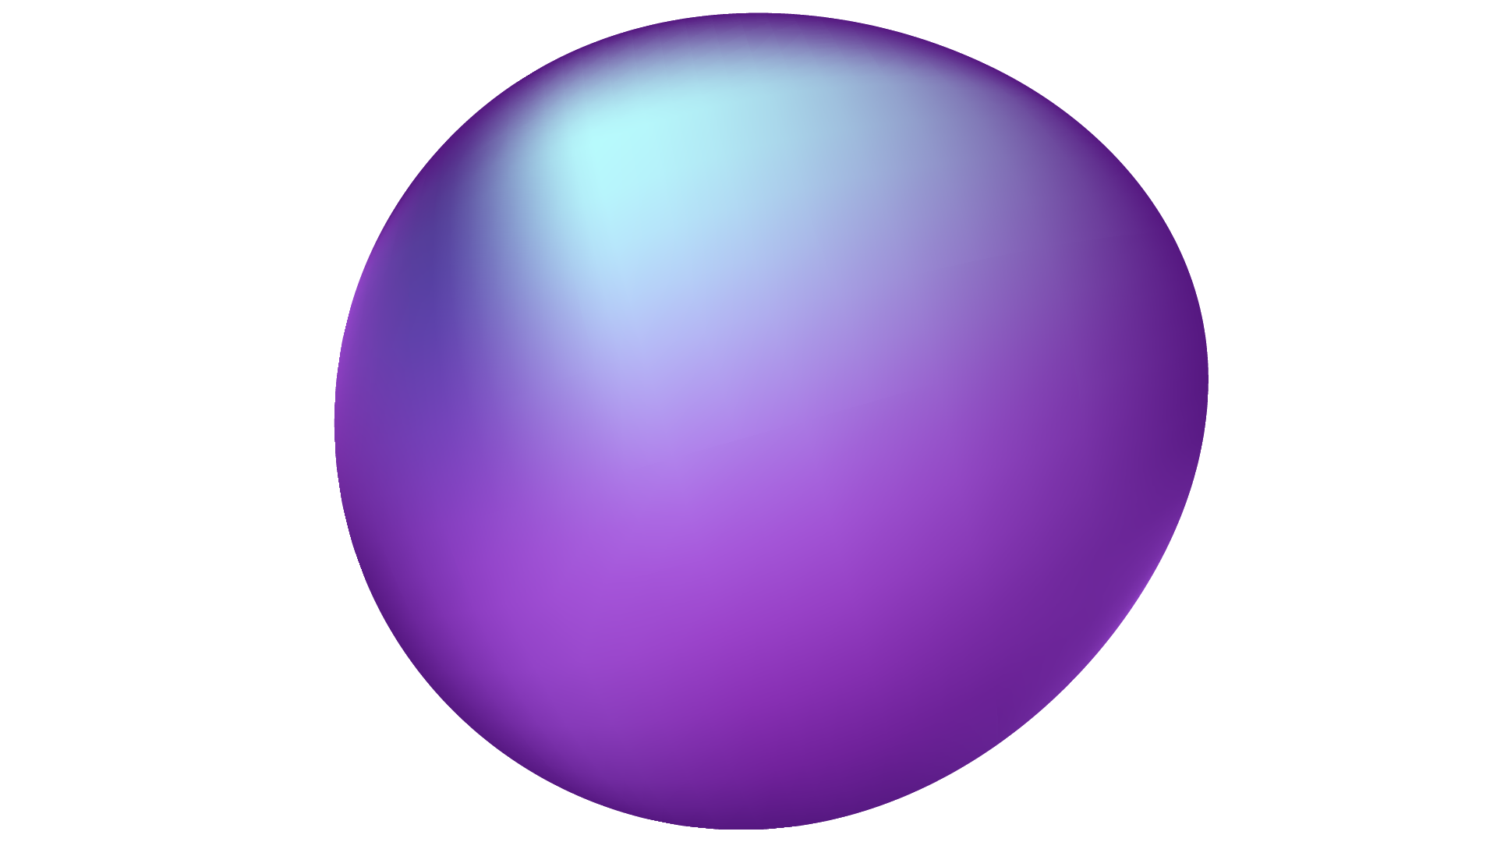
CONVOLUTIONAL AUTOENCODERS
Nitin Gupta

Slide 2
TABLE OF CONTENTS
01
02
03
04
05
Autoencoders?
CNNs?
Combining Autoencoders & CNNs
Real-World Use Cases
Applications

Slide 3
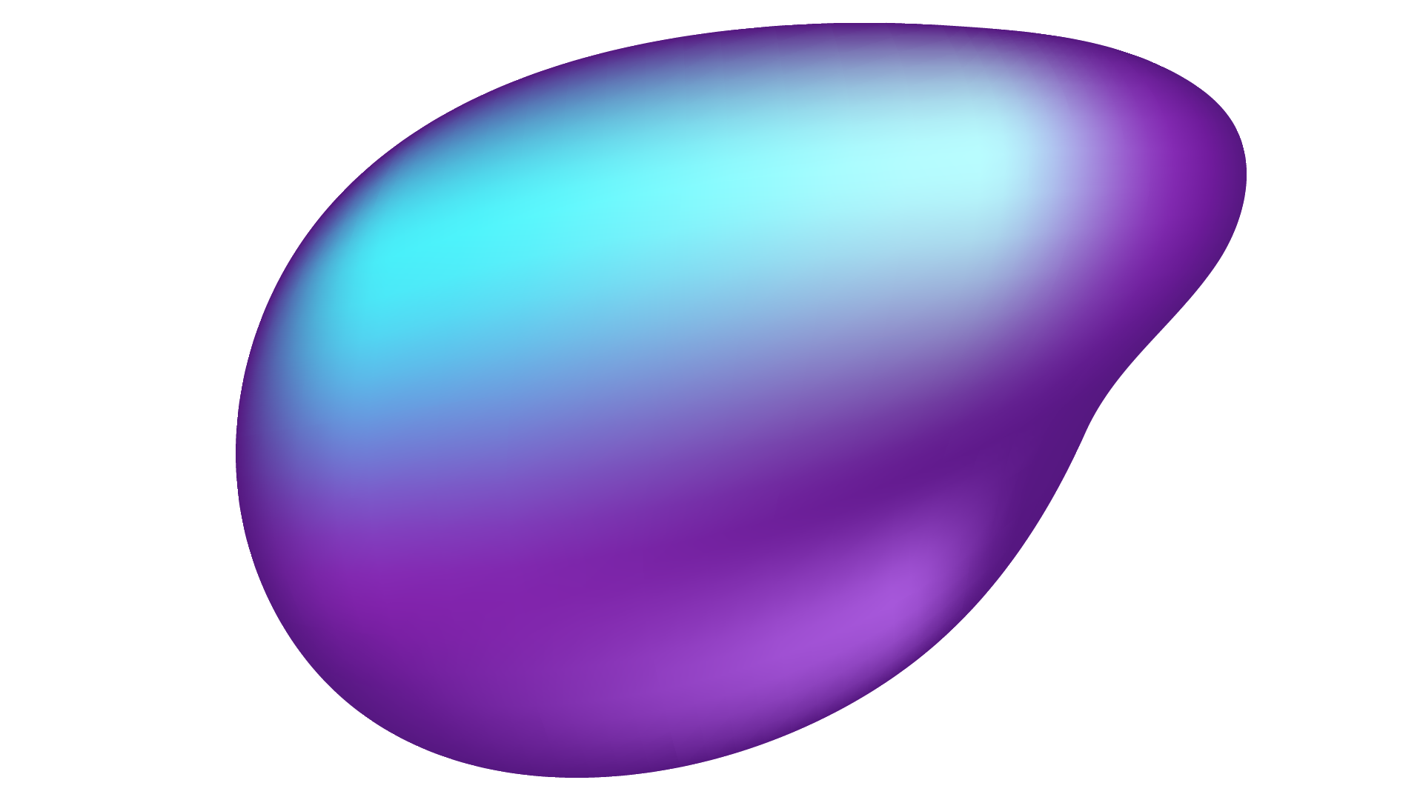

01
What is an Autoencoder?

Slide 4
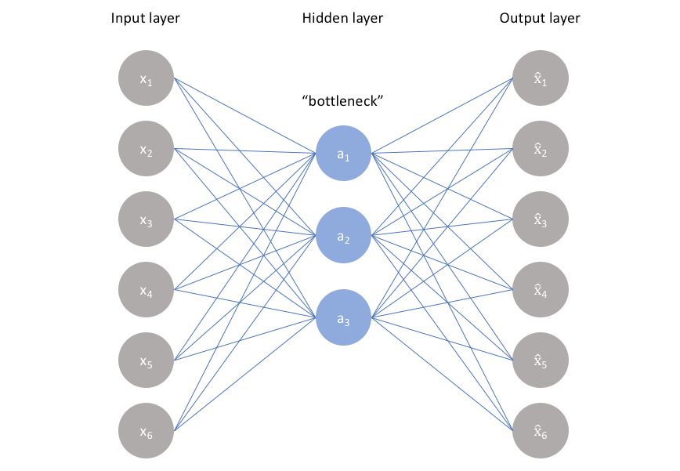
An unsupervised learning technique.
If the input features are dependent to each other (have some correlations), we can compress and reconstruct the features by imposing a bottleneck.
We want our autoencoder to be sensitive enough to recreate the original observation but insensitive enough to the training data such that the model learns a generalizable encoding and decoding.

Slide 5
02
What are CNNs?

Slide 6
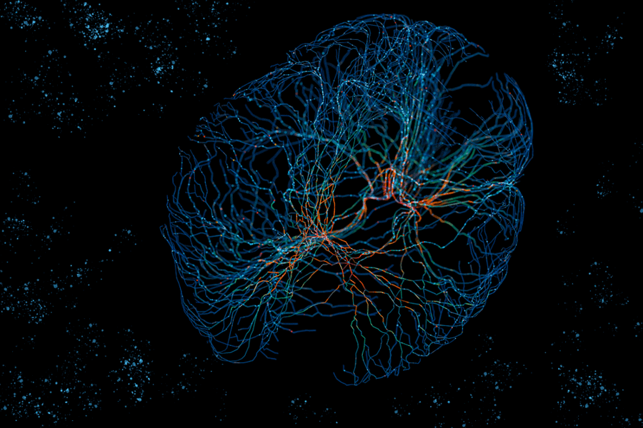
Usual neural networks work well on inputs that are structured and have a low number a dimensions.
However, images are unstructured and often contain a high number of dimensions.
For example, a colored image of 256 by 256 pixels will have 256*256*3 = 196,608 dimensions as an input. A one-layer neural network will have 196,6082 parameters!
So, neural networks need to exploit some special characteristics found in images.
Notes:
Unstructured data is data where individual data points do not carry any meaning when taken in isolation. When unstructured data is generated, there is no explicit relationship between the data points and their location in the content data layout.

Slide 7
IMAGE FEATURES
Translation Invariance
Locality
Neighboring pixels look similar or are correlated in some way
An objects’ appearance is usually independent of its location.
Notes:
Translation invariance example: a human face looks the same regardless of its positioning on an image (i.e. top, right, bottom, left).

Slide 8
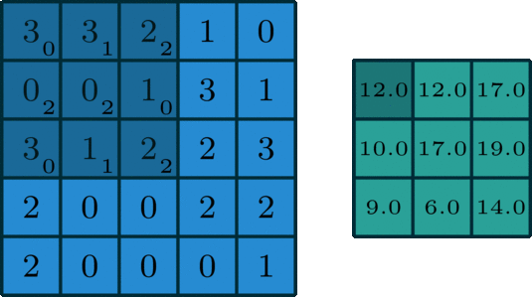
To incorporate the idea of locality in a neural network, we adjust the operations that take place between layers.
Instead of calculating the product between neurons, we will rather utilize rectangular areas, also known as receptive fields or kernels, that pass over the input while performing the operation of convolution.
Convolution between the input and a kernel leads to a smaller image in terms of dimensions.

Slide 9
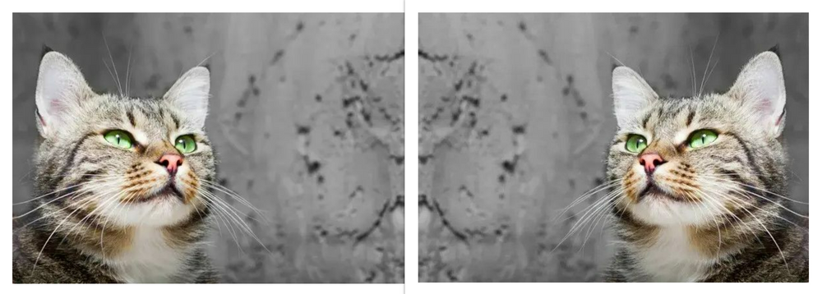
To incorporate the idea of translation invariance, we force the weights of a kernel to be shared across the input.
Notes:
More details when mentioning pooling

Slide 10
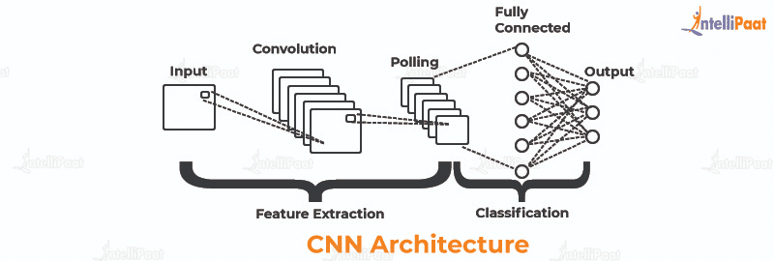
Kernels can be applied to an input in 4 different ways. These are 4 parameters that affect the convolution process.
Padding
Stride
Pooling
Dilation

Slide 11
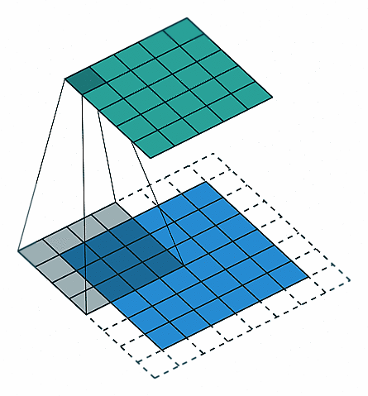
Padding
Padding adds extra pixels around the boundary (usually containing zeros).
By using padding, we can better control the output resolution, because the kernels will pay more attention to the edges of the image (since they will be at the center).
In a sense, padding helps preserve the input resolution.
Padding

Slide 12

Strides
The stride handles the step size of the receptive field when applying convolution.
A stride of 1 means the receptive field will be moving 1 step at a time, while a stride of 2 indicates a 2-step movement over the input.
Strides assist to reduce the spatial resolution for better processing.
Stride 2 Convolution

Slide 13
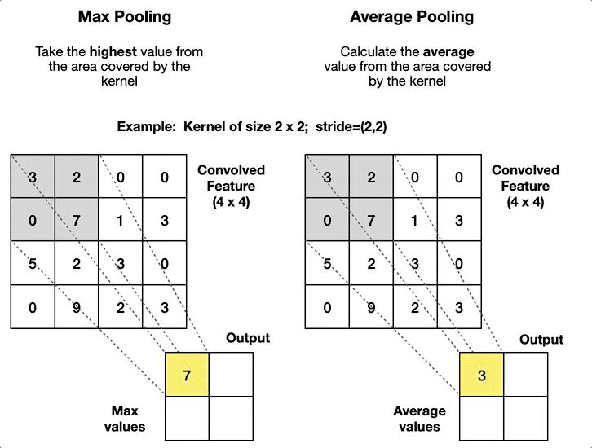
Pooling
Convolutional layers produce location-dependent feature maps, making the CNN sensitive to shifts in object positions.
Pooling layers provide "Translational Invariance," making the CNN invariant to small translations in the input.
Max pooling highlights prominent features, while average pooling smoothens the image while retaining essential features.

Slide 14
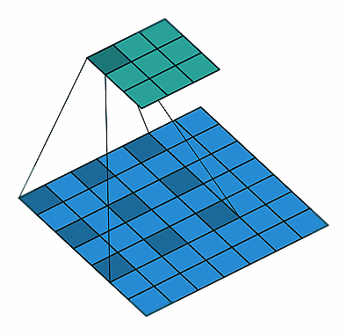
Dilation
The dilation handles the expansion of the receptive field.
A dilation of 1 means that a 3x3 receptive field will remain 3x3, while a dilation of 2 means that the same field will be transformed into a 5x5 field, since it was expanded by adding “holes” between the weights.
Dilation of 2

Slide 15
03
Combining Autoencoders & CNNs

Slide 16
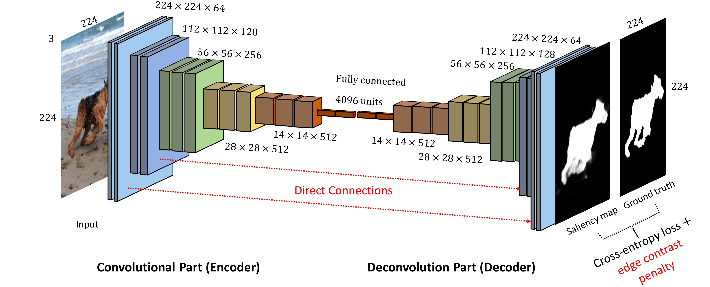
To combine convolutional layers in an autoencoders, we can replace the encoding portion with a normal CNN.
As for the decoding portion of the autoencoder, we need transposed convolutions which are the exact opposite of convolutions.
A convolutional layer decreases the resolution, while a transposed one increases it.

Slide 17

An example of strides and their transposed version
Stride 2 Convolution
Stride 2 Convolution Transposed

Slide 18
04
Real-World Use Cases

Slide 19
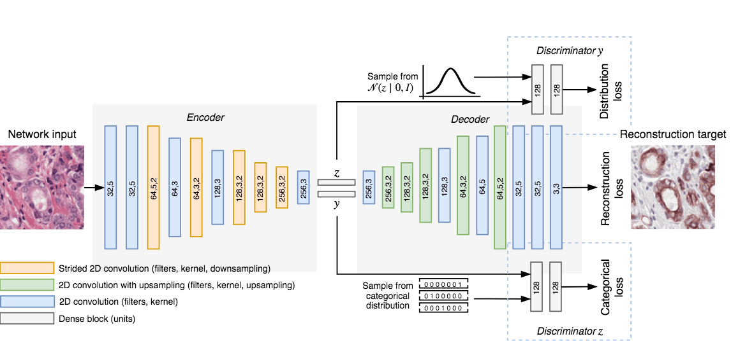
Cancer Detection
Notes:
Classifying prostate tissue as tumor or non-tumor without any labeled training data.
---
https://www.wouterbulten.nl/posts/unsupervised-cancer-detection-using-deep-learning-adversarial-autoencoders/
We propose an unsupervised method using self-clustering convolutional adversarial autoencoders to classify prostate tissue as tumor or non-tumor without any labeled training data.
Image: Overview of the clustering adversarial autoencoder (CAAE). By reconstructing an IHC patch from a H&E patch through a style vector, z, and a cluster vector, y, the network learns to cluster prostate tissue. This antibody-driven feature learning forces the network to learn more relevant encodings.

Slide 20
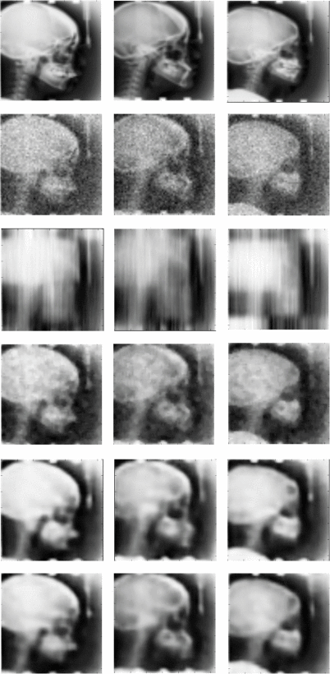
Medical Image Denoising
Notes:
Image: Denoising performance of CNN DAE on combined dataset,
top row shows real images,
second row is noisier version with minimal noise,
third row is denoising result of NL means,
fourth rows shows results of median filter,
fifth row is results of using smaller dataset (300 training samples) with CNN DAE,
sixth row is the results of CNN DAE on larger combined dataset.
Non-local means is an algorithm in image processing for image denoising.
---
https://ieeexplore.ieee.org/document/7836672:
Image denoising is an important pre-processing step in medical image analysis. In this paper, we show that using a small sample size, denoising autoencoders constructed using convolutional layers can be used for efficient denoising of medical images. Heterogeneous images can be combined to boost sample size for increased denoising performance. Simplest of networks can reconstruct images with corruption levels so high that noise and signal are not differentiable to human eye.

Slide 21
05
Applications

Slide 22
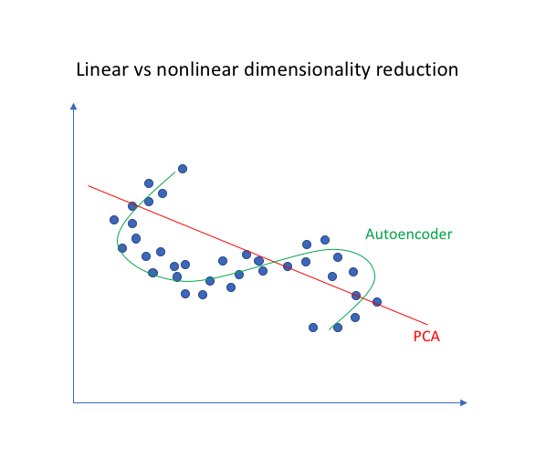
vs. PCA
Recall that Principal Component Analysis (PCA) uses linear algebra to transform and reduce dimensions.
In contrast, the autoencoder techniques can perform non-linear transformations with their non-linear activation function and multiple layers.
Thus, autoencoders show their merits when the data problems are complex and non-linear.
Notes:
Because neural networks are capable of learning nonlinear relationships, these autoencoders can be thought of as a more powerful (nonlinear) generalization of Principal Component Analysis (PCA).

Slide 23
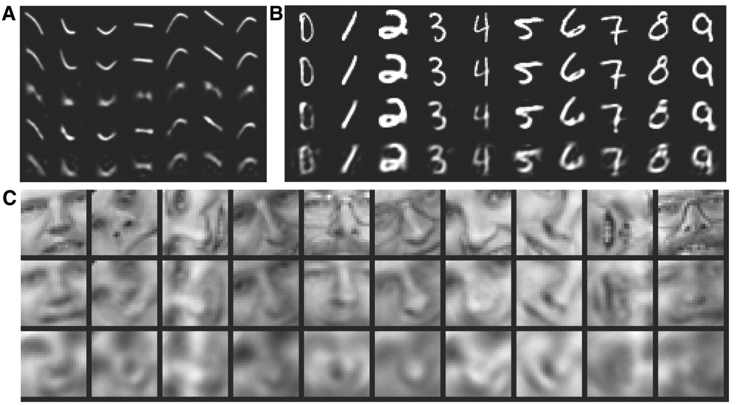
vs. PCA
A paper by Hinton and Salakhutdinov (2006) showed that training an autoencoder yielding a more minor errors compared to the first 30 principal components of a PCA and a better separation of the clusters.
Notes:
(Image A) Top to bottom:
Random samples of curves from the test data set.
Reconstructions produced by the six-dimensional deep autoencoder.
Reconstructions by “logistic PCA” (8) using six components.
Reconstructions by logistic PCA and standard PCA using 18 components.
(Image B) Top to bottom:
A random test image from each class.
Reconstructions by the 30-dimensional autoencoder.
Reconstructions by 30-dimensional logistic PCA and standard PCA.
(Image C) Top to bottom:
Random samples from the test data set.
Reconstructions by the 30-dimensional autoencoder.
Reconstructions by 30-dimensional PCA.

Slide 24
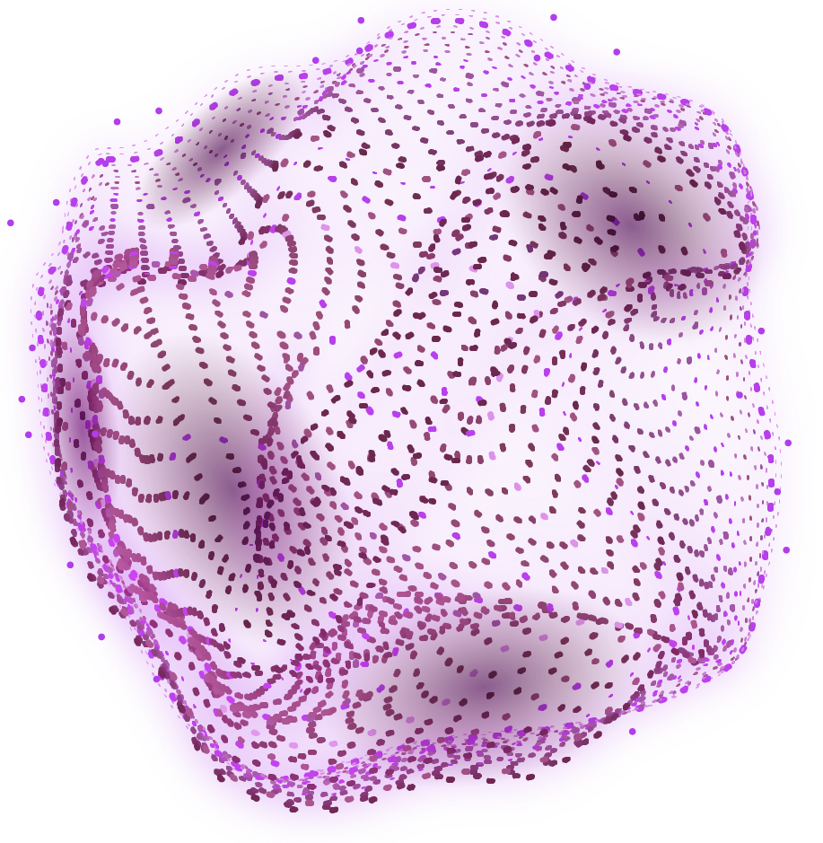
Image Coloring
Notes:
Lets color images.

Slide 25
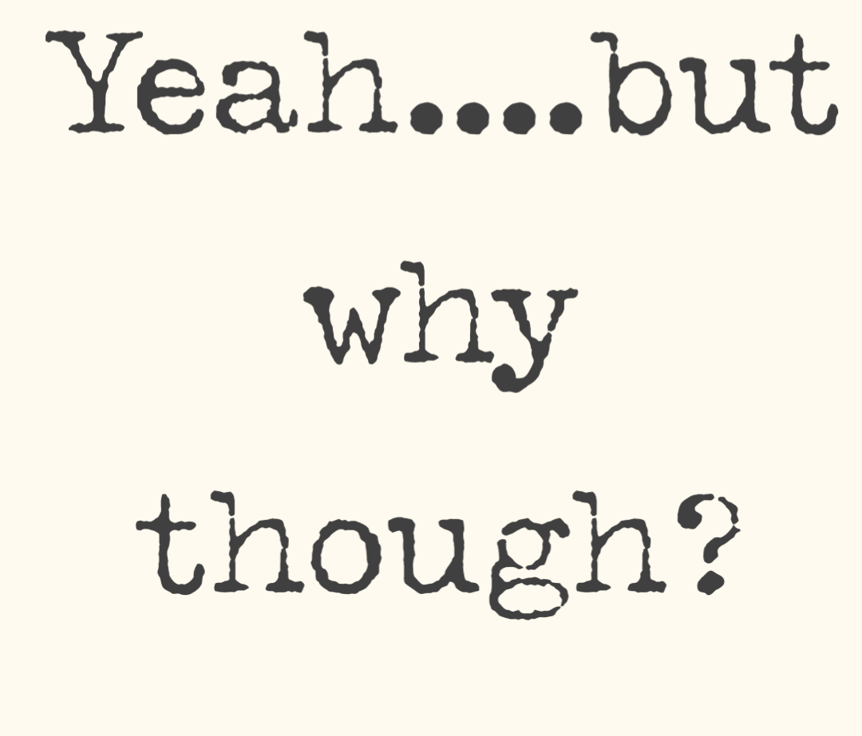
But Why?
Image colorization traditional often involved a large amount of human effort.
This problem is challenging because it is multimodal -- a single grayscale image may correspond to many plausible colored images. As a result, traditional models often relied on significant user input alongside a grayscale image.
Furthermore, image colorization is not only about adding realism but also about creating aesthetically pleasing visualizations. Artists and designers may use autoencoders to experiment with different color schemes and styles.
Notes:
To automate the process and to generate results that can fool the human eye is the goal of this project.

Slide 26
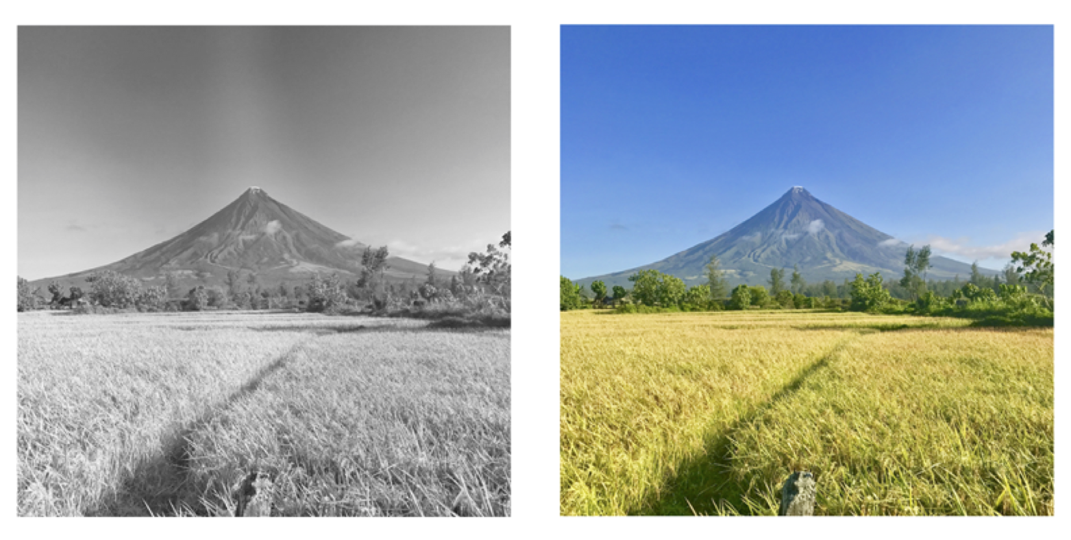
In image colorization, the goal is to build a model capable of applying realistic color to black and gray images.
However, since the input prompt is a black and gray image, we do not want to strictly recreate it, but enhance it in a sense.
Generally, images have the shape of (channels, width, height). The input images (black and white) contain only 1 channel, but their colorized versions (in RGB) contain 3 channels: red, green, and blue.

Slide 27
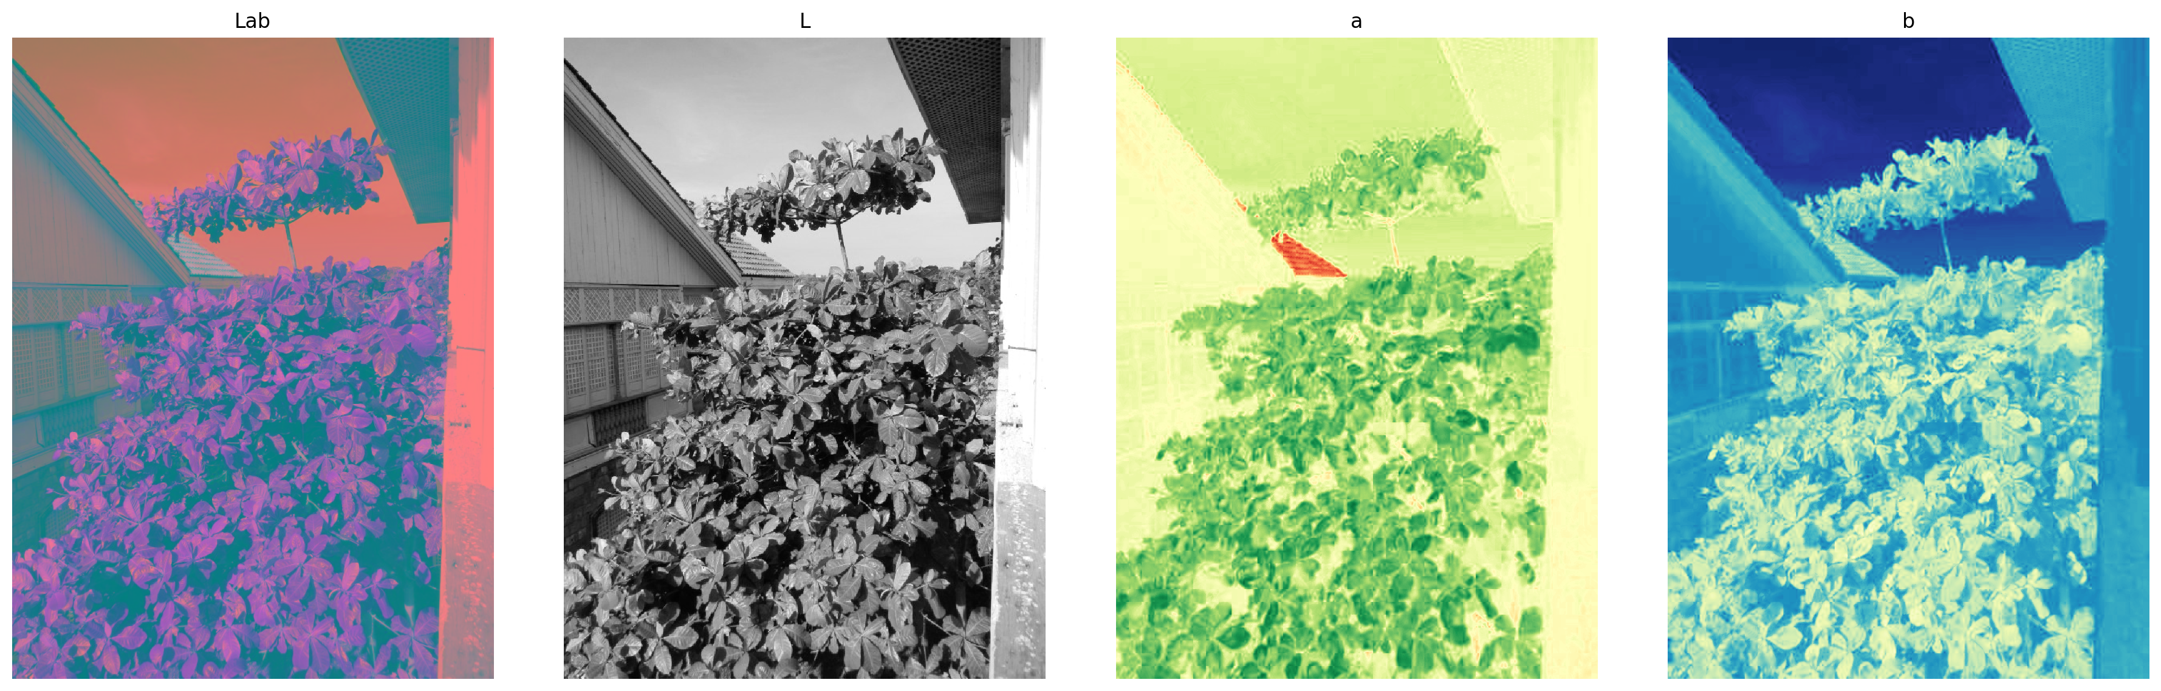
So, the autoencoder is deemed to generate 2 channels in total.
To simplify this, instead of using the RGB format, we can utilize the LAB format, where L indicates the lightness, a is the balance between green and magenta, and b is the balance between blue and yellow. Although LAB uses the same number of elements to illustrate a pixel, the L part is essentially our input image.
In other words, by using the LAB format the autoencoder will generate only 2 channels, a and b, considering that the third one, the L, will come from the input.

Slide 28
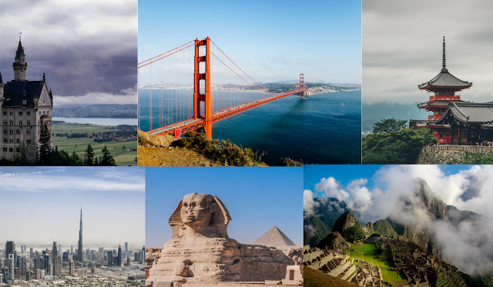
Data and Preprocessing
Before proceeding with the actual implementation, we need a large dataset containing colorized images. The chosen dataset is the Google Landmark Dataset containing approximately 5 million colorized images about human-made and natural landmarks.
The dimensions of the images vary, so only images of size 600x800x3 were chosen.
The only preprocessing that took place was the conversion of RGB to LAB format.

Slide 29


Architecture and Configuration
Activation function: ReLU
Optimizer: Adam
The batch size was set to 20, which means training the network with batches containing 20 images combined.
Epochs : 30
Number of parameters of the architecture: 889082
Training on around 10,000 (initially) and 28,000 images (final version).
Using Python, Pytorch, and Scikit-Image
The encoder will consist of convolutional layers and the decoder will contain transposed convolutional layers.
The input will be images of 600x800 with 1 channel, the L value (lightness). In the output, we will get a 600x800 image with 2 channels, the a and b values. The final colorized image will be constructed by combining the predicted a and b with the input L.
Notes:
A loss function measures the difference between the predicted output of a model and the actual output, while an optimizer adjusts the model's parameters to minimize the loss function.

Slide 30
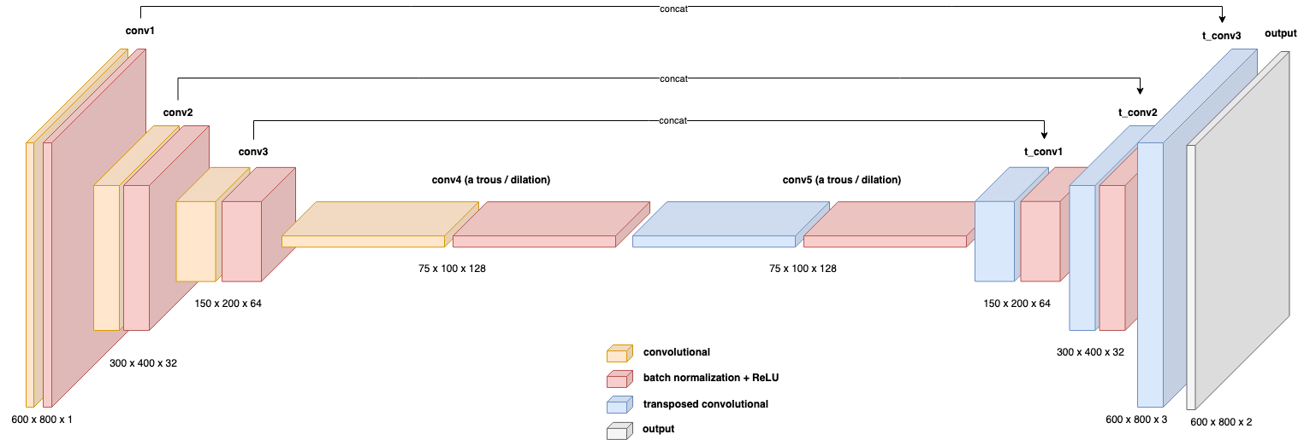
Architecture
Notes:
The U-Net layout uses previously calculated outputs of the encoder as inputs in the following parts of the decoder. In this way, we make sure the network does not lose any important information.

Slide 31
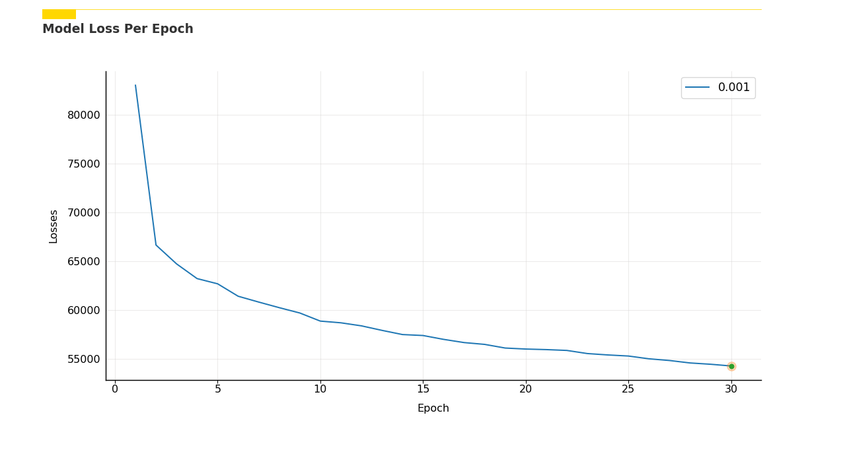
Notes:
Learning rate of 0.001
Training on around 10000 images.
Training time around 1 day.

Slide 32
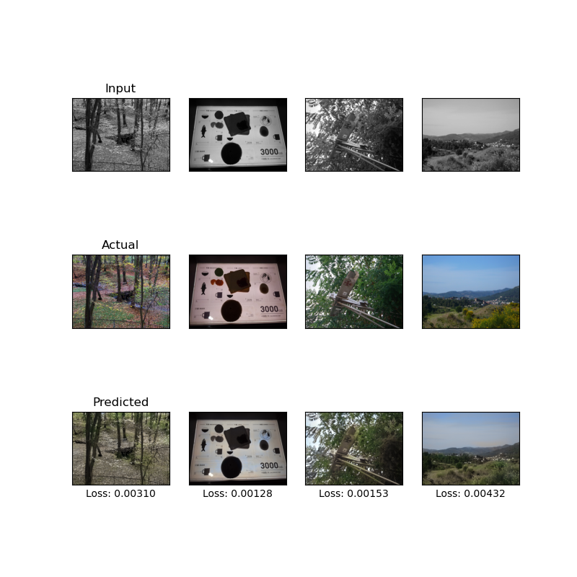
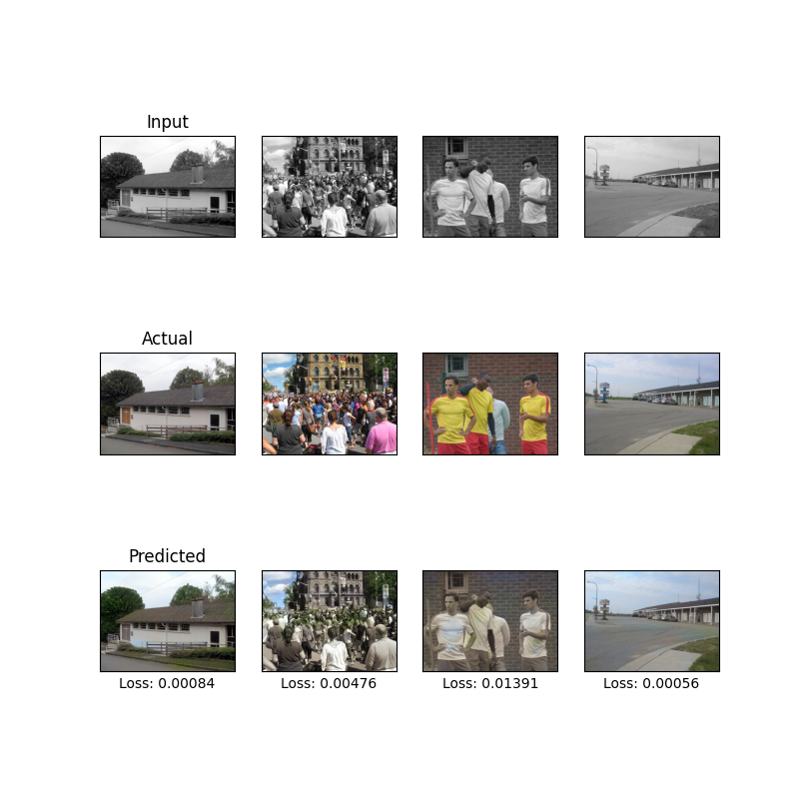
Learning Rate = 0.001
Training Set
Test Set

Slide 33
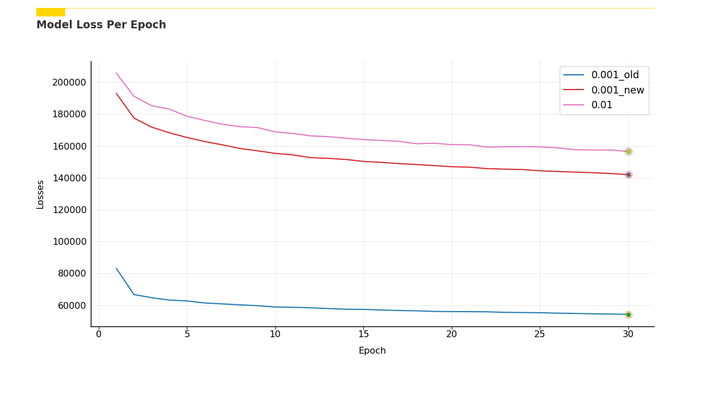
Notes:
New learning rates of 0.001 & 0.01
Training on 28411 images.
Training and testing time for 0.001_new: around 46 hours
Training and testing time for 0.01: around 26 hours

Slide 34
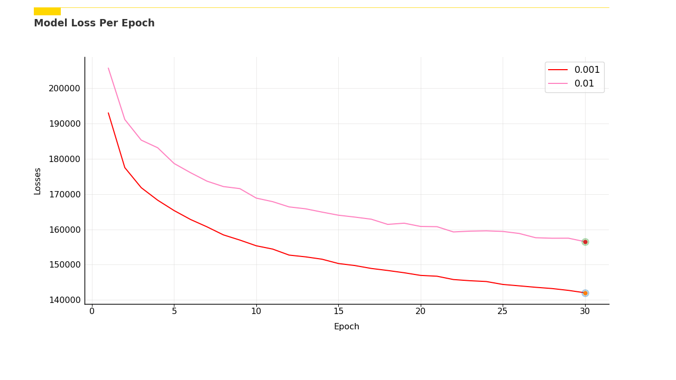
Notes:
Same as previous, but with the old 0.001 learning rate removed.

Slide 35
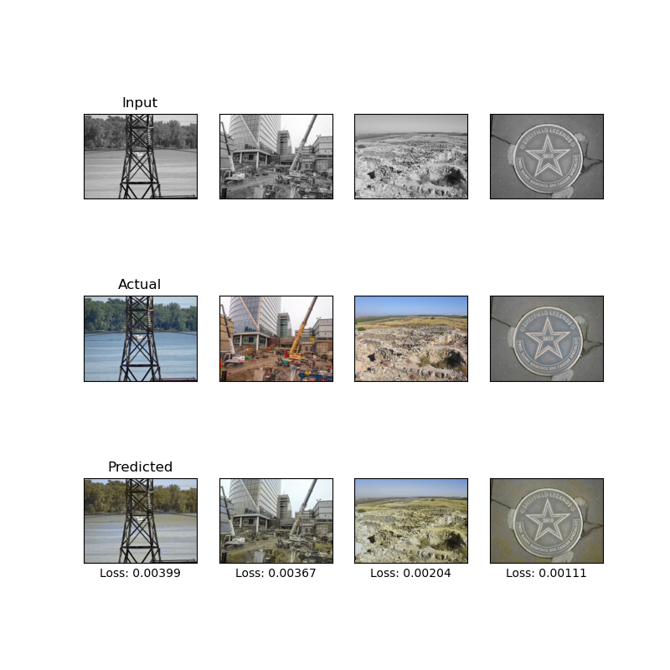
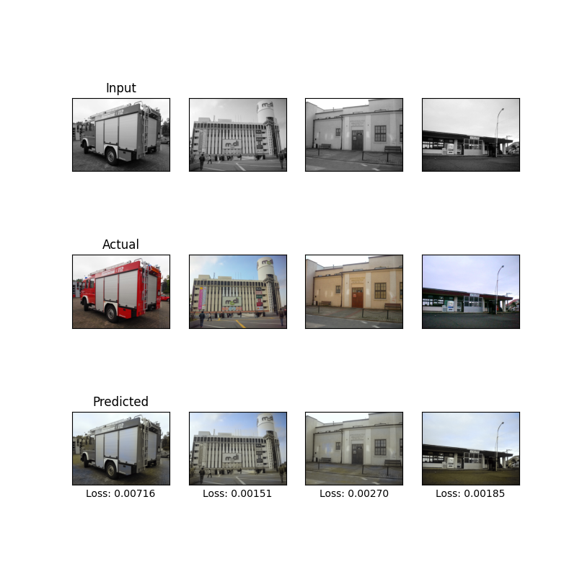
Learning Rate = 0.01
Training Set
Test Set

Slide 36
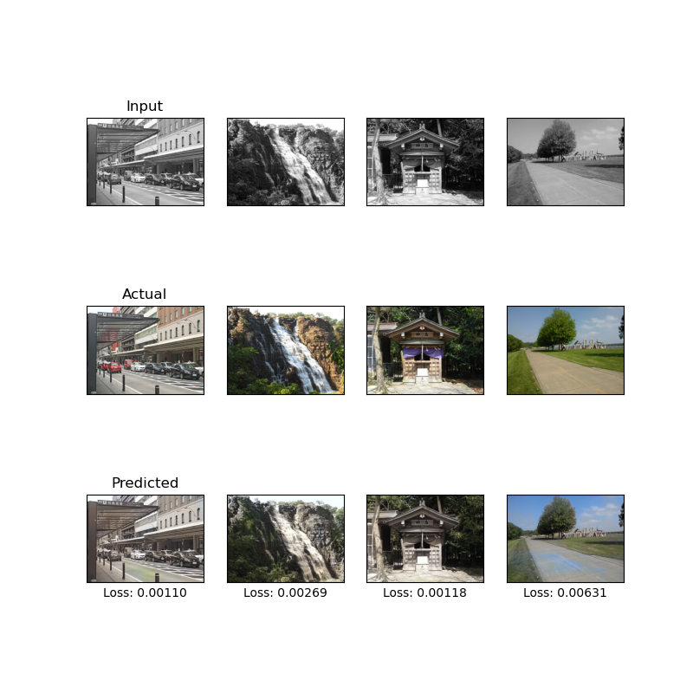
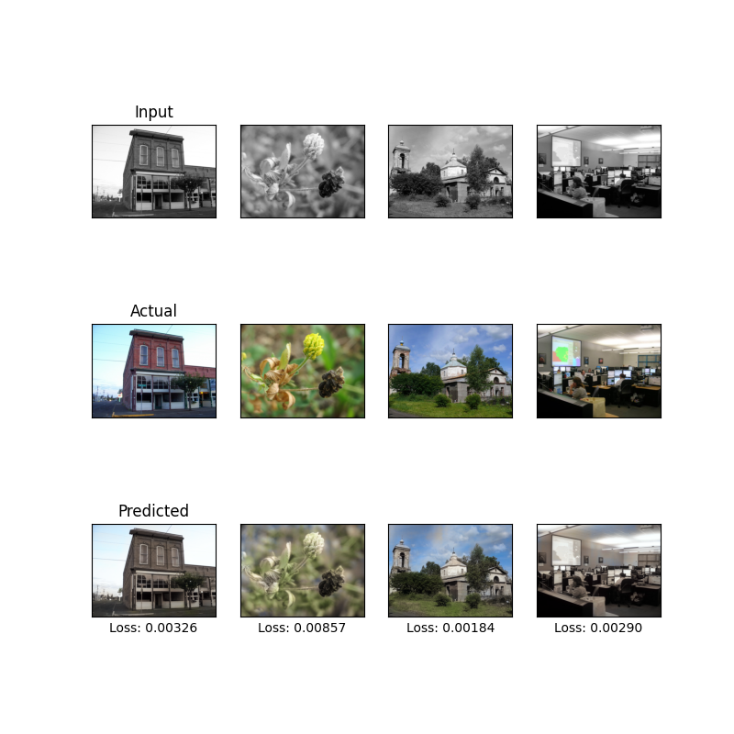
Learning Rate = 0.001 (new)
Training Set
Test Set

Slide 37
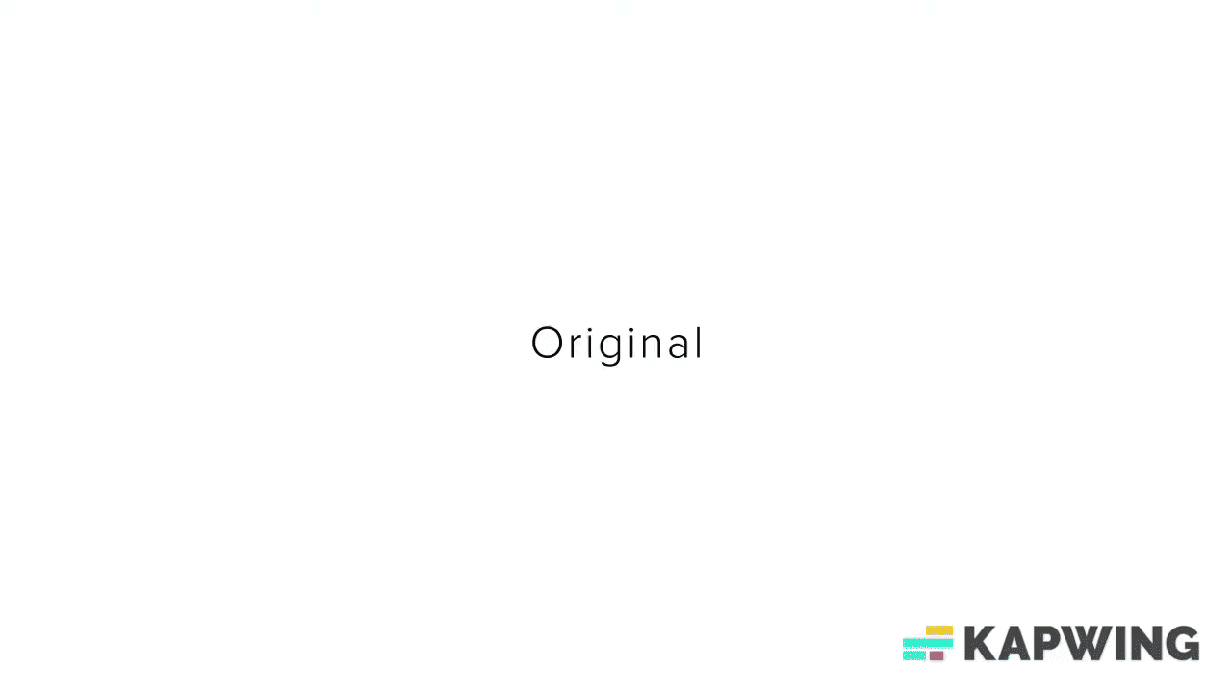
Further Improvements & Steps
More training images.
Testing with other architectures.
Varying epochs.
Varying batch sizes.
Use GPUs!
Apply on videos.
Example of Coloring a Video

Slide 38
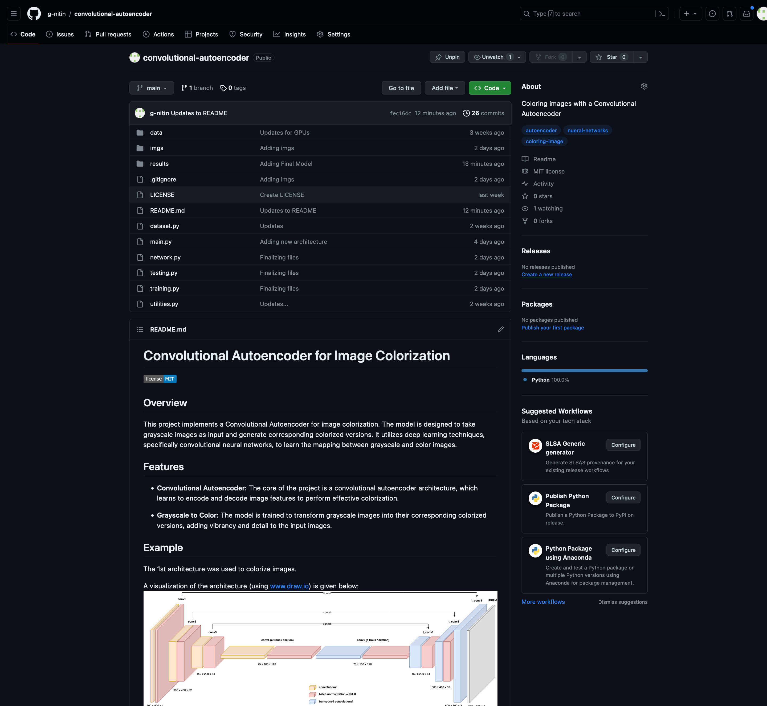
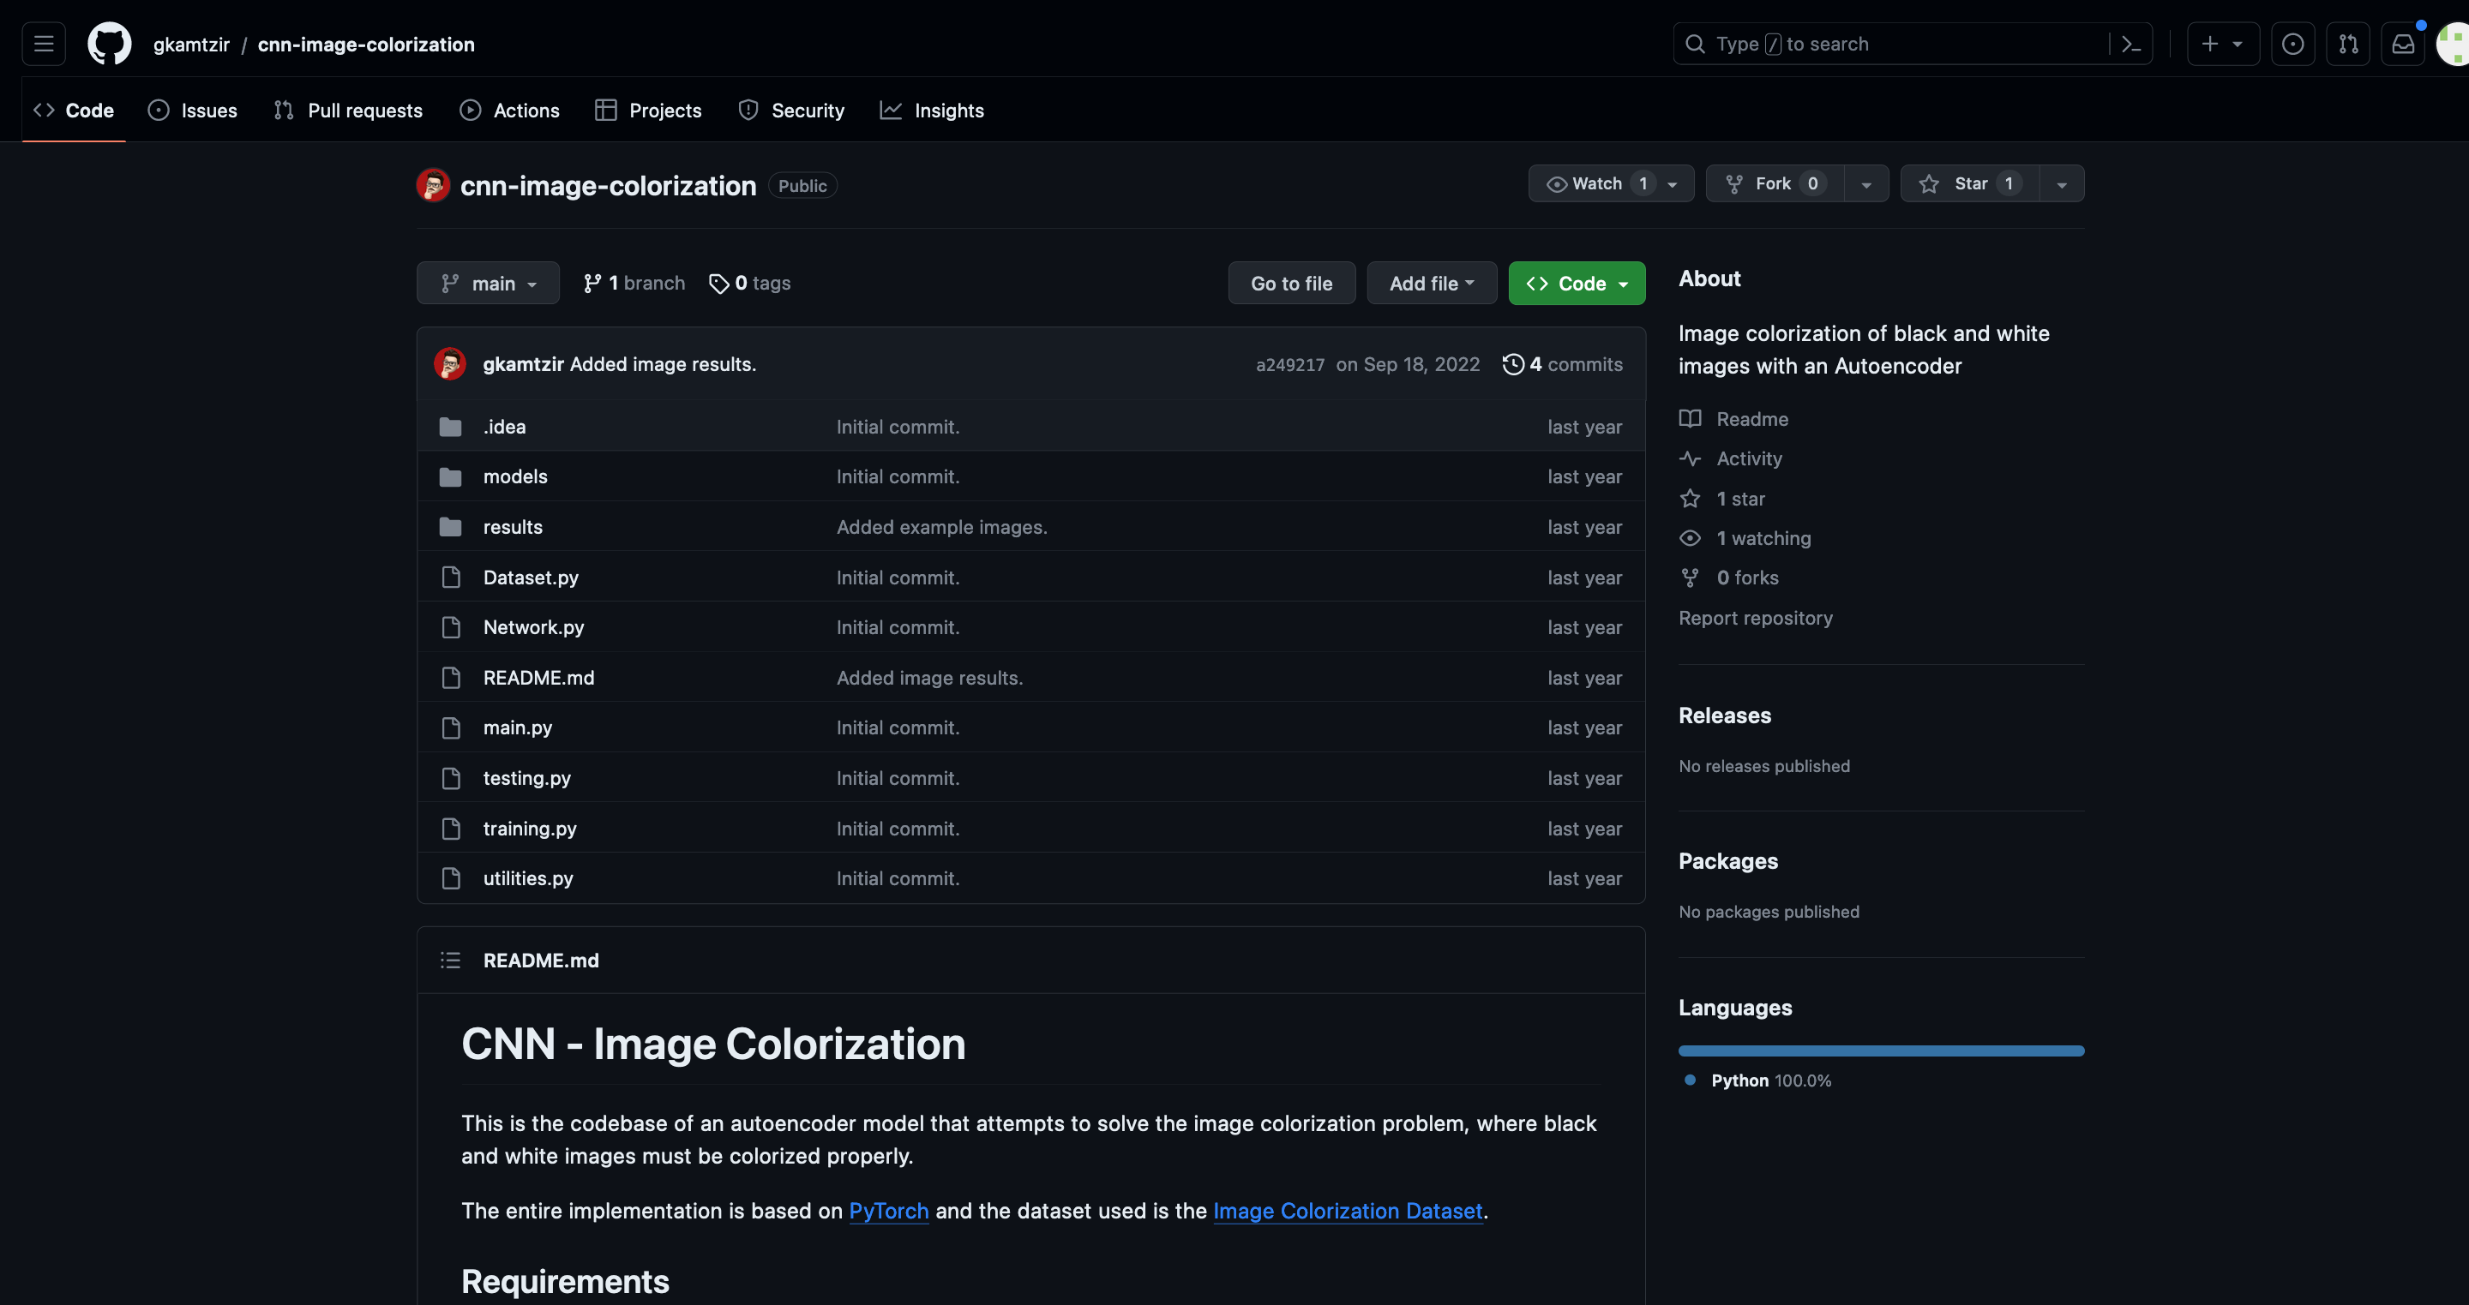
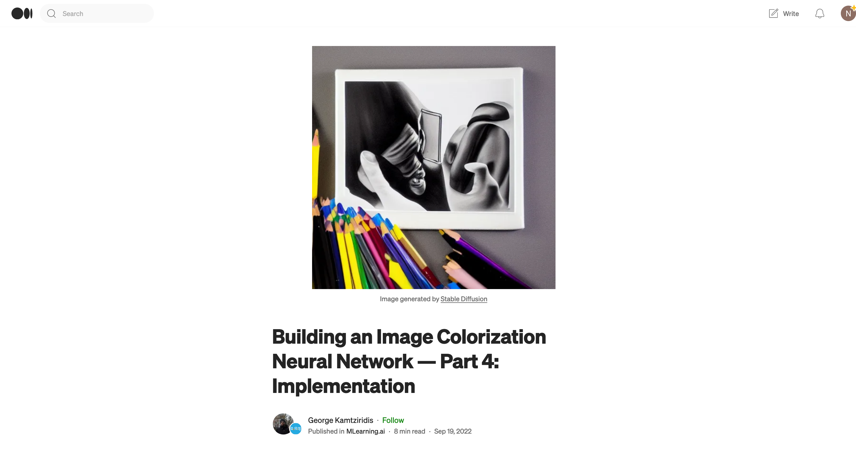
Acknowledgements

Slide 39
Information Sources
github.com/gkamtzir/cnn-image-colorization
github.com/g-nitin/convolutional-autoencoder
www.jeremyjordan.me/autoencoders/
www.medium.com/mlearning-ai/building-an-image-colorization-neural-network-part-1-generative-models-and-autoencoders-d68f5769d484
www.ieeexplore.ieee.org/document/7836672
https://www.wouterbulten.nl/posts/unsupervised-cancer-detection-using-deep-learning-adversarial-autoencoders/
www.towardsdatascience.com/anomaly-detection-with-autoencoder-b4cdce4866a6
www.science.org/doi/10.1126/science.1127647
https://xiangyutang2.github.io/auto-colorization-autoencoders/

Slide 40
Image Sources
www.intellipaat.com/blog/tutorial/artificial-intelligence-tutorial/convolution-neural-network/
www.blog.paperspace.com/pooling-and-translation-invariance-in-convolutional-neural-networks/
www.towardsdatascience.com/intuitively-understanding-convolutions-for-deep-learning-1f6f42faee1
www.pub.towardsai.net/introduction-to-pooling-layers-in-cnn-dafe61eabe34
www.github.com/vdumoulin/conv_arithmetic/tree/master/gif
www.github.com/arthurmeyer/Saliency_Detection_Convolutional_Autoencoder
www.github.com/PacktPublishing/Advanced-Deep-Learning-with-Keras/tree/master/chapter3-autoencoders
https://commons.wikimedia.org/w/index.php?curid=34991651
https://commons.wikimedia.org/wiki/File:PyTorch_logo_icon.svg
https://images.app.goo.gl/jtFvCod4FXQGVXy36
https://www.youtube.com/watch?v=LluZarKPY-o

Slide 41
THANKS!
ANY QUESTIONS?

Slide 42
Backup Slides
Notes:
Lets color images.

